Slide 1
WeatherPy Analysis
DataFrame Tree

Slide 2
1500 Random Coordinates List
lats = np.random.uniform
lngs = np.randome.uniform
Merge into random pairs lats and lngs to create Tuple lat_lngs
lat_lngs = zip(lats, lngs)
Create a list coordinate_list = list(lat_lngs)
coordinate_list[(1,2), (2,3), (3,4)]
Create a list-variable cities[] for holding 600+ cities
For coordinate in coordinate_list:
city (temp variable) = citipy.nearest_city(coordindate[0], coordinate[1]).city_name
If city not in cities:
cities.append(city)
For Loop (>600 cities)

Slide 3
Build city_url To “get” weather data in JSON format
url = "http://api.openweathermap.org/data/2.5/weather?"
city =“Boston”
city_url = url + "appid=" + weather_api_key + "&q=" + city + “&units=imperial”
city_weather = requests.get(city_url)
city_weather.json
boston_data = city_weather.json
boston_data[‘sys’][‘country’]
Parse data using
boston_data [‘coord’][‘lat’] or boston_data[‘main’][‘temp_max’]

Slide 4
Initialize city_weather_data and get weather data for each city in json format
city_weather_data = []
dimension counters and initialize to 1
record_count = 1 set_count = 1
For i, city in enumerate(cities)
city_url = url + "appid=" + weather_api_key + "&q=" + city
city_weather = requests.get(city_url).json()
city_lat, city_lng_city_max_temp, city_humidity, city_clouds, city_wind, city_country, city_date
city_weather_data.append({"City": city.title(), …… })
city_weather_data_df = pd.DataFrame(city_weather_data)
city_weather_data_df.head(10)
output_data_file = "weather_data/cities.csv“
city_weather_data_df.to_csv(output_data_file, index_label="City_ID")

Slide 5
Data Exploratory Phase
city_data.cvs
ride_data.cvs
Operations Performed on df’s
Count
Isnull.sum
Dtypes
Type.unique
city_data_to_load
ride_data_to_load
city_data_df
ride_data_df
Merge on “city” and create pyber_data_df
(city, data, fare, ride_id, driver_count, type)
* No missing data was found in either df.

Slide 7
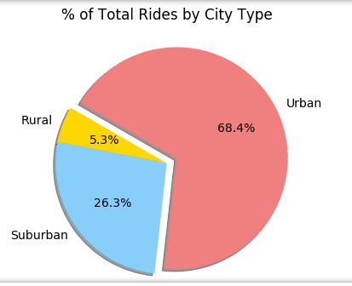
pyber_data_df
(city, data, fare, ride_id, driver_count, type)
Groupby type list(index) ride_id_percents_by_type
Get sum of all ride_id total_ride_id
Calculate percent by city type
ride_percents by city type

Slide 8
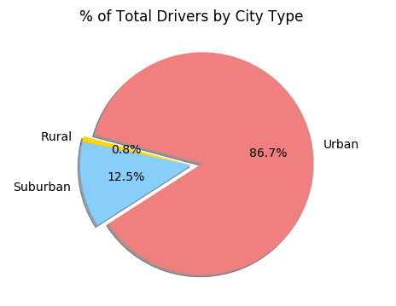
pyber_data_df
(city, data, fare, ride_id, driver_count, type)
Groupby type list(index) driver_count by city type
Get sum of all drivers
driver_count
Calculate percent by city type
driver_percents by city type

Slide 9
Challenge 5 – Summary DF
pyber_data_df
(city, data, fare, ride_id, driver_count, type)
city_data_df
Groupby type (index) total_rides_by_type
Groupby type (index) total_fares_by_type
Groupby type (index) total_drivers_by_type
Calculate using lists
avg_fare_per_ride by city type
Calculate using lists
avg_fare_per_driver by city type
Create summary_df by merging all 5 lists using city_type as index
Format columns

